Slide 1

Do I have MonkeyPox?
Mark Anthony De Castro
Kiran Songire
Raj Kalsaria

Slide 2
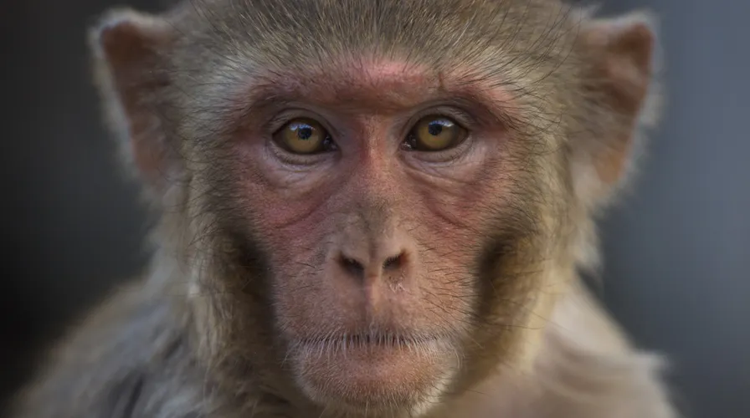



Introduction
----

Slide 3
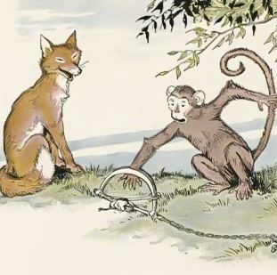

What is MonkeyPox?

Slide 4

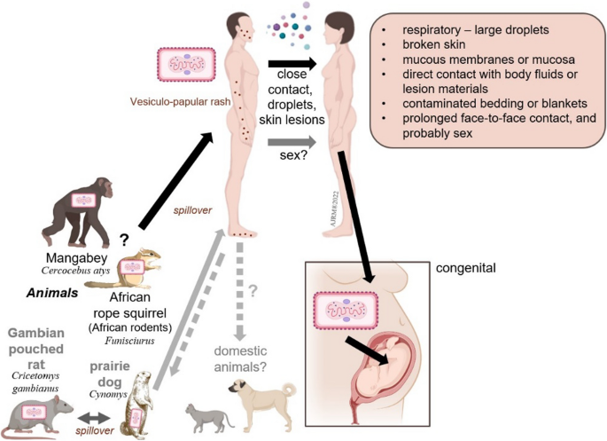


Symptoms
Headache
Fever
Muscle ache
Low energy
Back pain
Swollen Lymph Node
Rashes (in 2-3 weeks) may happen on hands, soles, feets, groin, genitals/anus regions.

Slide 5
Attributes
 | Positive MP | Negative MP | Neg Symptoms/+MP | Neg Symptoms /-MP
Rectal Pain | 8702 | 3643 | 7207 | 5448
Sore Throat | 8370 | 4184 | 7539 | 4907
Penile Oedema | 8398 | 4214 | 7511 | 4877
Oral Lessions | 8258 | 4228 | 7651 | 4863
Solitary Lessions | 8197 | 4330 | 7712 | 4761
Swollen Tonsils | 8055 | 4478 | 7854 | 4613
HIV Infections | 8887 | 3697 | 7022 | 5394
STD Infections | 8662 | 3784 | 7247 | 5307

Slide 6
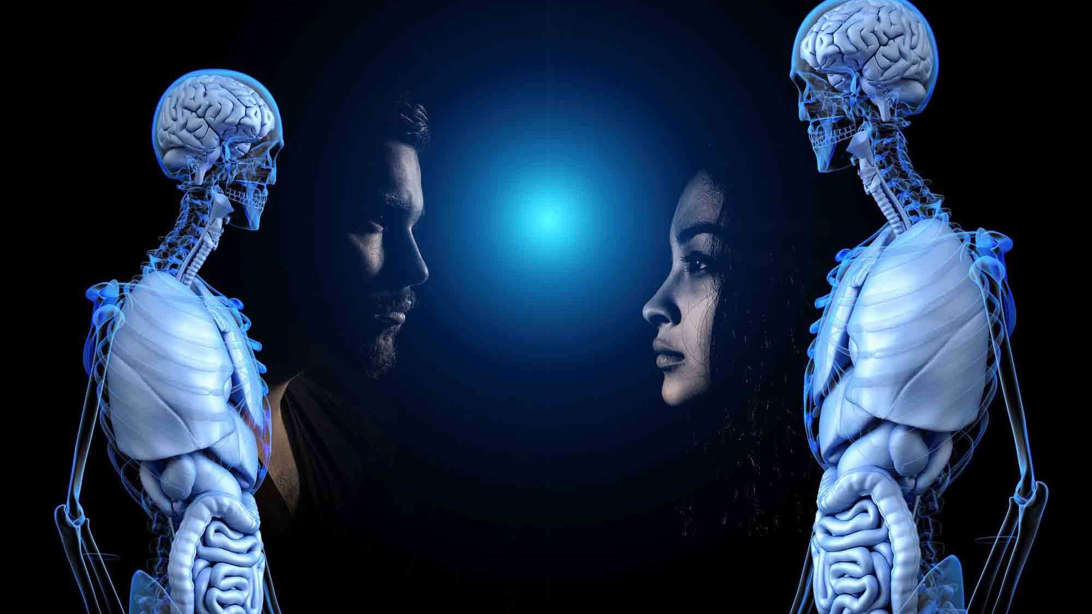
Patient A VS. Patient B

Slide 7
Probability of MonkeyPox|Symptoms
PATIENT A
PATIENT B
1. HIV Positive
2. Rectal Pain
1. Swollen Tonsils
2. No Solitary Lesion

Slide 8
Content 2
Subtitle
subtitle
subtitle
Add text, images, art, and videos.
Add transitions, animations, and motion.
Save to OneDrive, to get to your presentations from your computer, tablet, or phone.
Open the Design Ideas pane for instant slide makeovers.
When we have design ideas, we’ll show them to you right there.
Add text, images, art, and videos.
Add transitions, animations, and motion.
Save to OneDrive, to get to your presentations from your computer, tablet, or phone.
Open the Design Ideas pane for instant slide makeovers.
When we have design ideas, we’ll show them to you right there.
Add text, images, art, and videos.
Add transitions, animations, and motion.
Save to OneDrive, to get to your presentations from your computer, tablet, or phone.
Open the Design Ideas pane for instant slide makeovers.
When we have design ideas, we’ll show them to you right there.

Slide 9


Thank You
Questions?

